Slide 1
Mid Term Presentation
Yordi Kremer
Mabs4.0

Slide 2
Content
Problem/Opportunity
Assignment
Last sprint
Next sprint
Current results

Slide 3
Problem/Opportunity
Move4Vitality
Garmin
Greater reach
Indepent from activitytrackers

Slide 4
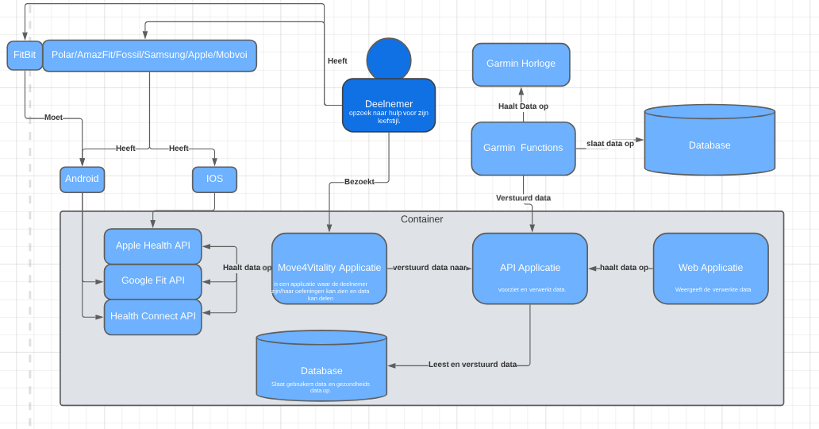
Assignment

Slide 5
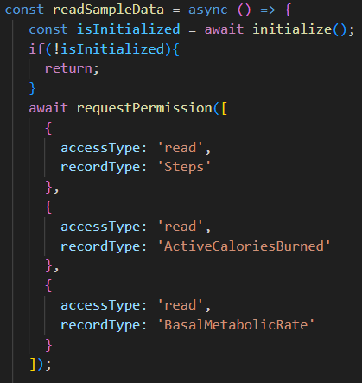
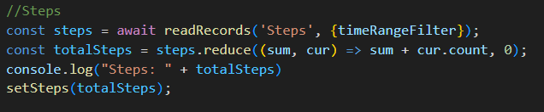
Last Sprint
Health Connect
Steps
Basal Metabolic Rate
Burned Calories
Permissions
Start and End date
Package

Slide 6
Next Sprint
Apple Health
Steps
Basal Metabolic Rate
Calories Burned
Mac Book

Slide 7
Current Results

